Slide 1
DCHI WEBINAR
TIF POLICIES HOUSING
Gale Price, AICP, EDFP
Economic Development Office
November 19, 2020

Slide 2
DCHI WEBINAR
TIF POLICIES HOUSING
Janesville Background
Problem Set
  Housing Issues
  Community Education
  Process
Economic Development Program
  Links Between Housing and ED
Other Housing Projects
River Flats Affordable Project

Slide 3
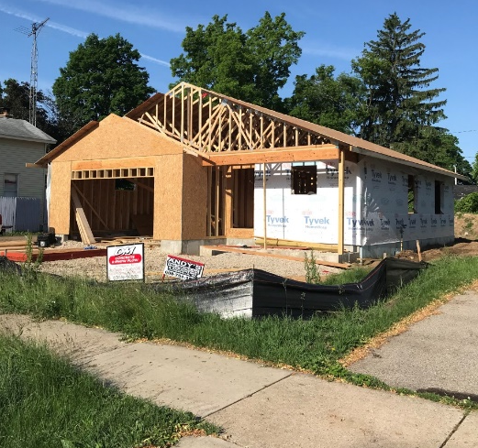
DCHI WEBINAR
TIF POLICIES HOUSING
2008, Closure of GM
  Economy Tanks, Construction Dropped Off
  Double Whammy for Janesville
  Construction Crawled
    218 New S&2F Permits 2007
    97 New S&2F Permits 2017
    110 New S&2F Permits 2020
  No New MF Since 2006, AH Since 1999
  Stable Population

Slide 4
DCHI WEBINAR
TIF POLICIES HOUSING
Successful Economic Development Programs
2013 - 2017
  26 Projects
  Leveraged $133 Million In Investment
  1100 Guaranteed New Jobs
  Other Projects Self Sustained

Slide 5
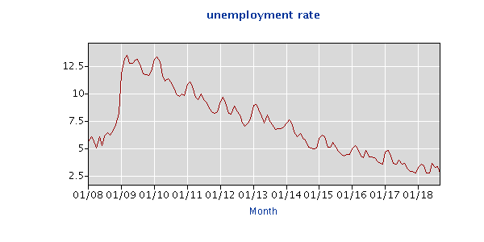
DCHI WEBINAR
TIF POLICIES HOUSING
A Gradual and Slow Recovery
  Single Digit Unemployment, July, 2011
  3+ Unemployment, July, 2017
  July, 2017 87,640 In workforce/ 4800+ more
No Decrease In Population

Slide 6
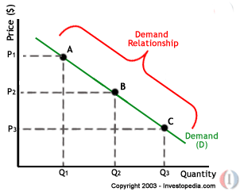
DCHI WEBINAR
TIF POLICIES HOUSING
Developed A Housing Issue.
  Real Impacts?
    Demand Greater Than Supply
    Spikes In Costs to Develop
    No Rent Growth
    Local Unmet Needs
    Labor Impacts
    Squeeze On Affordable
How Do We Change This?

Slide 7
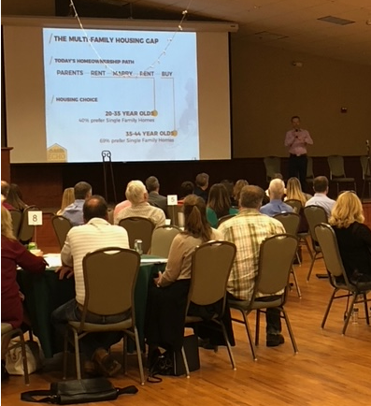
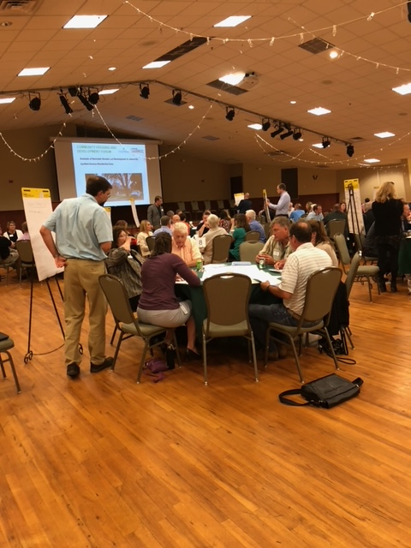
DCHI WEBINAR
TIF POLICIES HOUSING
Housing Shortage/Issues In Janesville?
  Forward Janesville (Chamber) and City Both Summits
Wide Exposure
  Outside Groups
  Education
  Needs Discussion
  Financing Gaps
  Path Forward

Slide 8
DCHI WEBINAR
TIF POLICIES HOUSING
Path Forward
  City is Dire Need of Housing
  City Needs to Partner
    Accept This Does Not Solve Itself
    Close Financial Gap
    Identify Opportunities
  Address ALL Housing Needs
    Price Points
  Starts At Policy Level

Slide 9
DCHI WEBINAR
TIF POLICIES HOUSING
ED Policies
  Economic Development Policy 61 A and B
    Industrial and Commercial ED Policies
      Multifamily Development Not Permitted
      TIF
    Council Discussions
      July and September
      Definition if “Infill”
    September 2018 – Policy Adopted
      Council Cited Community Opportunity/Need
      TIF Closure, Extension for Affordable, JRB Discussions

Slide 10
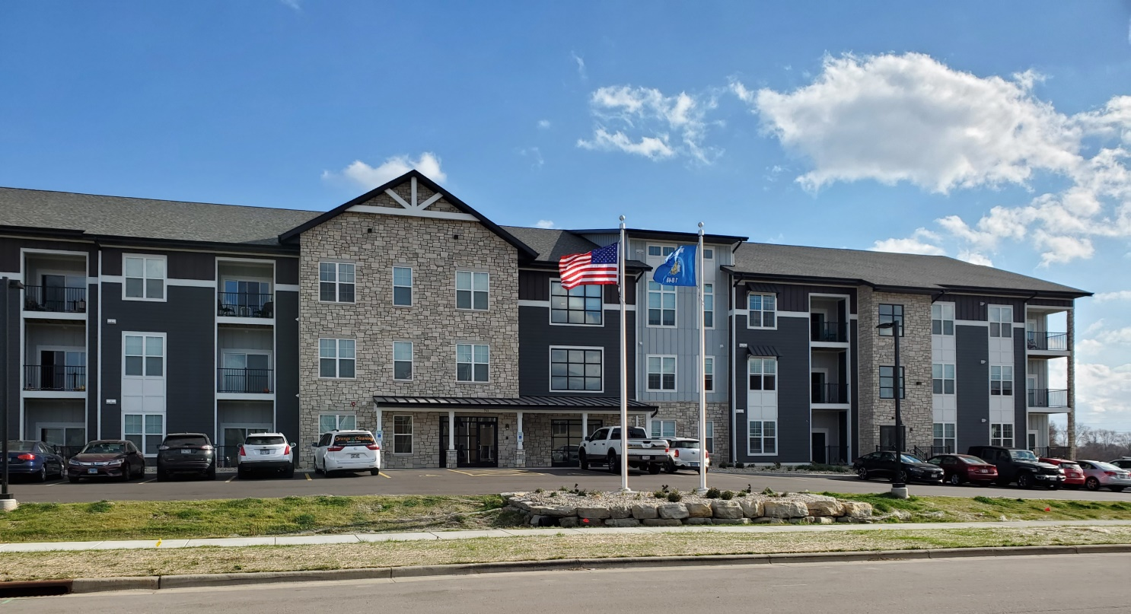
DCHI WEBINAR
TIF POLICIES HOUSING
Along Comes The Project Discussions
  The Glade, 260 High End, 89 Completed

Slide 11
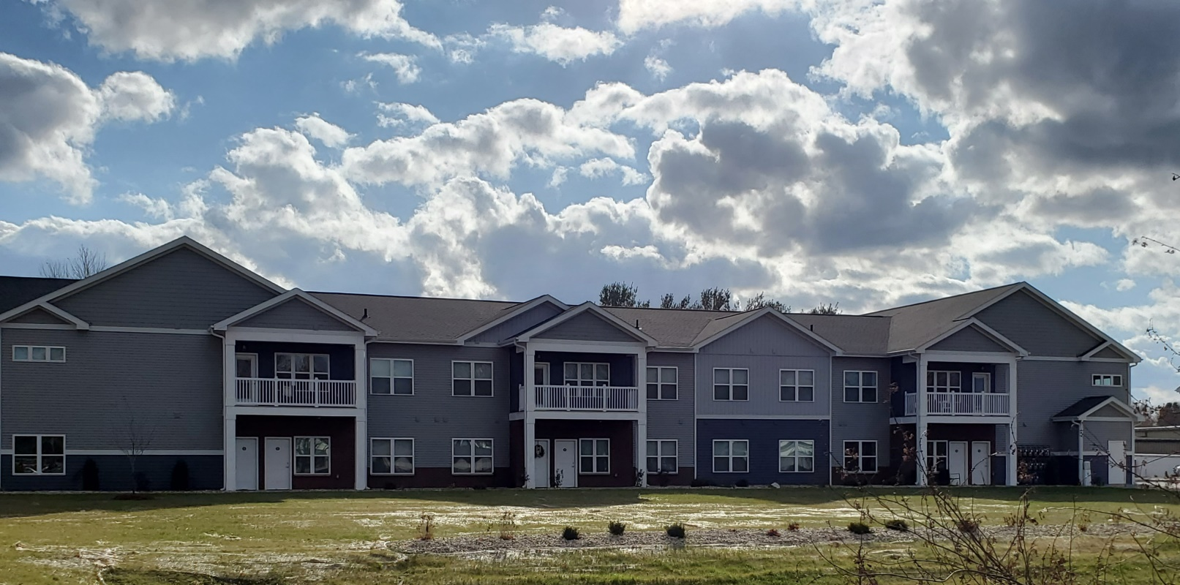
DCHI WEBINAR
TIF POLICIES HOUSING
Along Comes The Project Discussions
  Diamond Ridge, 115 Market Rate

Slide 12
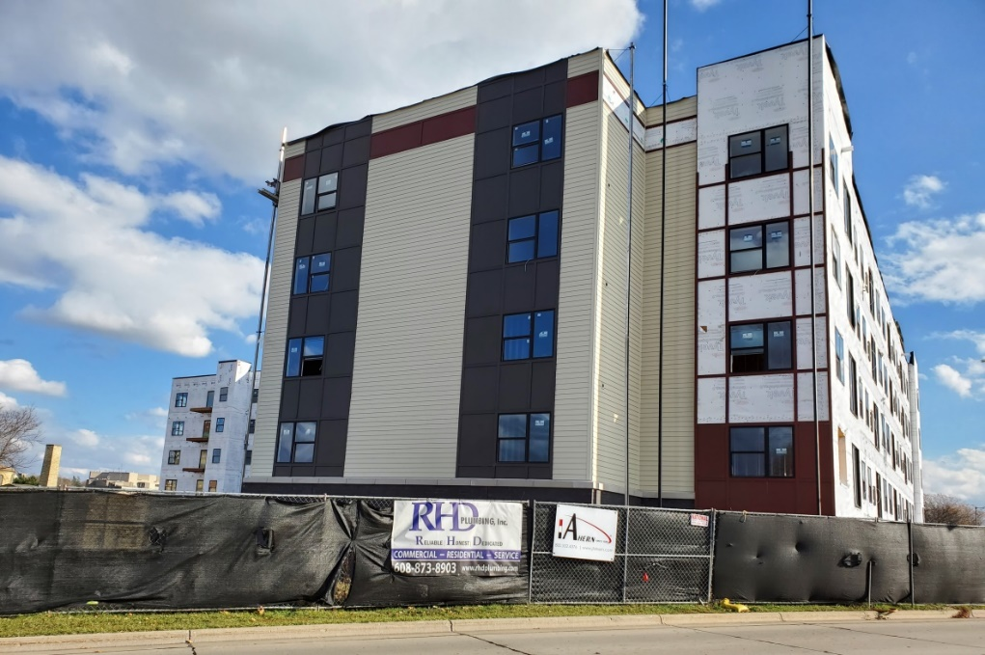
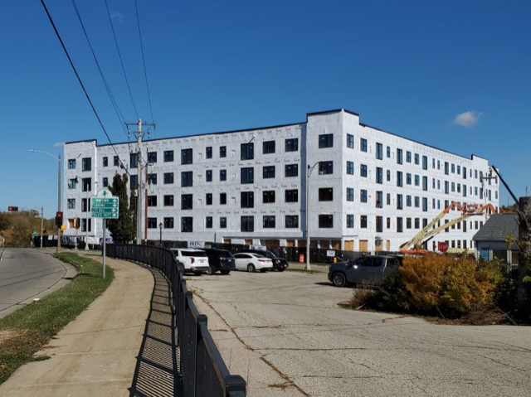
DCHI WEBINAR
TIF POLICIES HOUSING
Along Comes The Project Discussions
  River Flats Project, Downtown 92 LIHTC

Slide 13
DCHI WEBINAR
TIF POLICIES HOUSING
River Flats
  November 2018 – Initial Discussions

Slide 14
DCHI WEBINAR
TIF POLICIES HOUSING
River Flats
  May 2019
    Tax Credits
  Transition
  Fall, 2019
    Negotiation

Slide 15
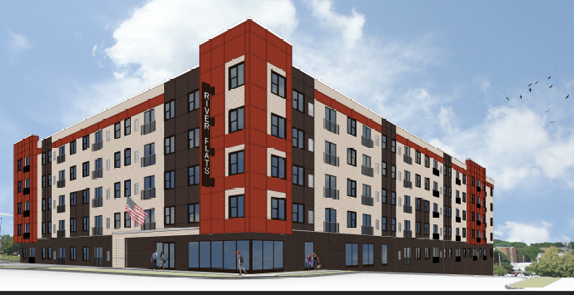
DCHI WEBINAR
TIF POLICIES HOUSING
River Flats
  Angst?
  Perception
  Convincing
  Financial Package Negotiation

Slide 16
DCHI WEBINAR
TIF POLICIES HOUSING
Complexity In Structure
  Evaluation Standard
    LIHTC Not Traditional IRR
    Developer Fee Out
  Really was a “STACK” for Sources of Funds
  Free City Land
    CDBG, Relocation
    Tax Increment Financing – Closed District, Adjoining District, Paygo
    HOME

Slide 17
DCHI WEBINAR
TIF POLICIES HOUSING
Complexity In Structure
Paygo $1.905 Million Actual
Taxable Value, $4.8 Million

Slide 18
DCHI WEBINAR
TIF POLICIES HOUSING
Internal Debate
  Investment Per Unit
  HUD Updated Rental Rates and Incomes
  Need to Support All Market Sectors
  December 2019 and January 2020, Return of Policy Debate…..Infill vs. Brownfields vs. Greenfields

Slide 19
DCHI WEBINAR
TIF POLICIES HOUSING
Approved February 24th
Opening April 2021
Summary - Importance
  Housing Needed Across Board
  Hit Three Market Segments, Different Product
  Housing For Everyone
  Long Road, Persuasion
  Creating Additional Interest Community / Downtown

Slide 20


Hope you found this informative.
Please contact the (Gale Price, Economic Development Office) for more information.
608-755-3059
www.ci.janesville.wi.us

