Slide 1
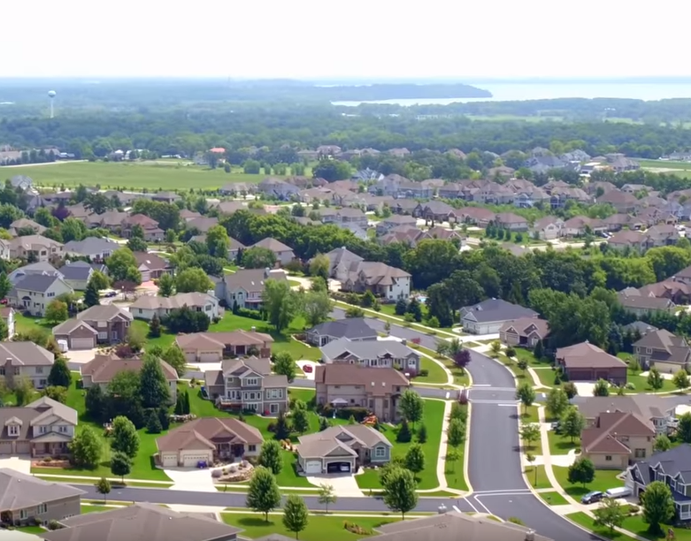
Waunakee Housing Task Force – Process, Results and More To Do…
Todd Schmidt, Village Administrator / Economic Development Director
Village of Waunakee
Kristin Runge, PhD.
Community Development Institute
Division of Extension
University of Wisconsin-Madison

Slide 2
Agenda
Background Context & Process
Dane County & Waunakee
Flashpoint
Group Process
Report Content & Key Findings
Results & Outcomes
Lessons Learned
Q/A
Notes:
Notes:
Moment of silence to digest and reflect
Sharon to report back from chat

Slide 3
Village of Waunakee
State Capitol
Suburban Community North of Madison
1990: 5,987 residents
2020: 14,399 residents
20,000 additional households expected between 2018 and 2040

Slide 4
Background Context & Process
Image by Paul Whitley, via Flickr
https://www.flickr.com/photos/nbsinyk/5154118365

Slide 5
Context
Dane County expected to add 20,000 additional households between 2018 and 2040

Slide 6
Village of Waunakee Home Inventory by Fair Market Value
Red shaded area indicates homes that meet affordability requirement for 80-100% of area median income for a family of four per HUD rules;
Vertical blue line denotes median single-family home value; Data provided by Waunakee Village Hall, April 2019; Total single family housing units =3,591;
Notes:
This is a graph of the fair market value of homes in 2018
Red shaded area indicates homes that meet affordability requirement for households making 80-100% of area median income for a family of four
Blue line indicates the median home value in Waunakee in 2018
Looking at this graph and the previous graph on the change in income distribution, and it appears that there isn’t a sufficient housing supply to sustain an adequate number of middle class households

Slide 7
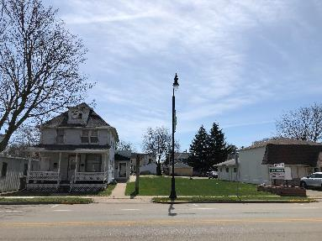
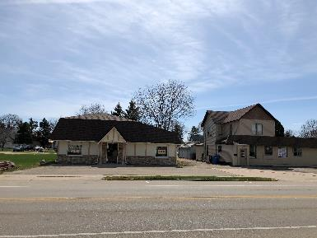
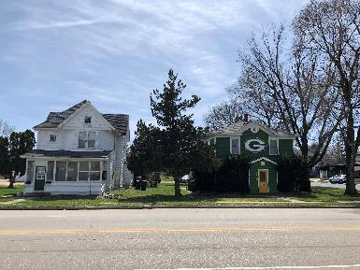
The Flashpoint
A proposed luxury apartment complex in a residential block of Main Street Waunakee that would have replaced these buildings
Notes:
This is the Main Street side of a traditional block, comprised primarily of residential homes
All homeowners had initially agreed to property sale
Adjacent residents organized and successfully protested the development
Series of contentious and increasingly angry public meetings over the development

Slide 8
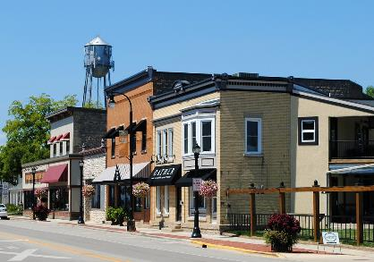
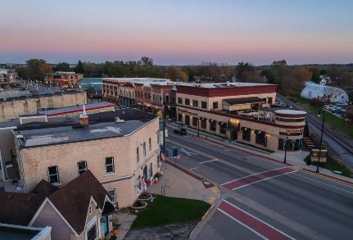
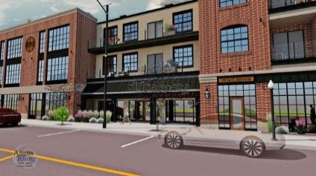
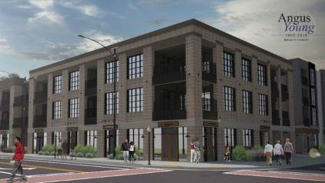
The Flashpoint
Proposed during a time period in which adjacent blocks of Main Street had been redeveloped, and single family homes had been occasionally replaced by mixed use apartment buildings.
Notes:
This is facing East on Main Street, the picture in the upper left corner is the end of the first section of commercial real estate on Main Street
The bottom two pictures are renderings of projects that have been completed but were underway at the time the scuttled development was proposed

Slide 9
Waunakee Housing Task Force Group Process
Image by Paul Whitley, via Flickr
https://www.flickr.com/photos/nbsinyk/5154118365

Slide 10
Goal: Representative Task Force
Notes:
With the public controversy in the background, the Village Board asked Extension to help lead a community process to identify and address housing concerns
We decided on a study group approach, with the intent of building capacity to address this issues and issues in the future
Residents were invited to apply to be part of the Task Force, and selection was made by the Village president in consultation with the Village administrator and Village engineer
Race and ethnicity were particular challenges for a variety of reasons
Otherwise, the group represented different socio economic, geographic and demographic groups

Slide 11
Goals: Village
The Village Board has created the Waunakee Housing Task Force to gain a full understanding of the existing housing inventory in Waunakee, identify areas of realistic housing need in which the Waunakee housing marketplace ought provide supply, and craft potential policy modifications.

Slide 12
Steps in the Process
Negotiate Extension role
Assist in creating participant selection grid
Village creates committee
Design the educational program
Monthly meetings
Survey design and implementation
Decision making

Slide 13
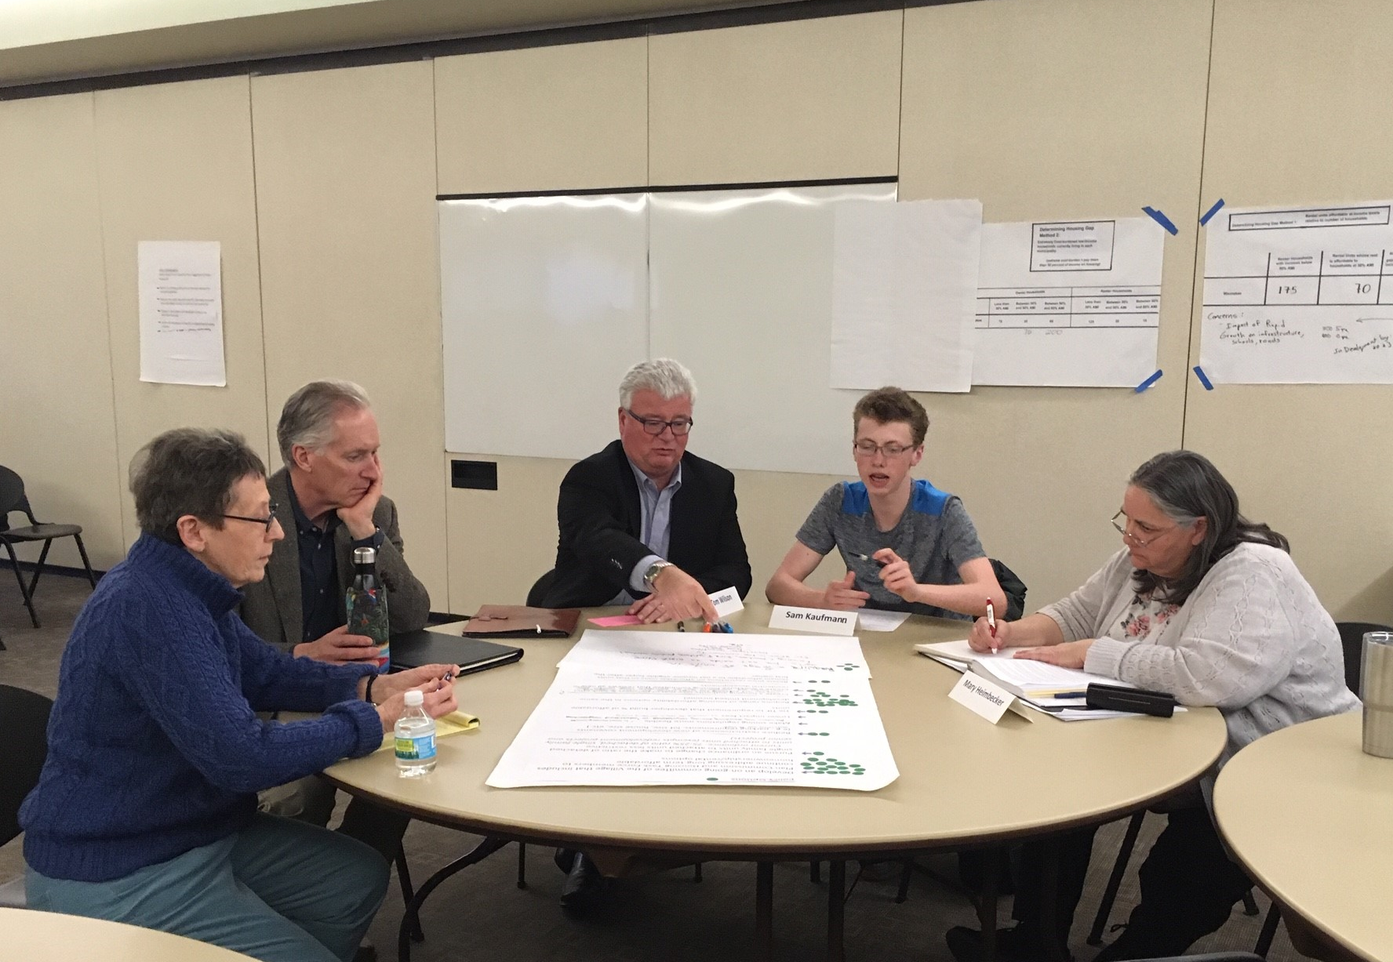
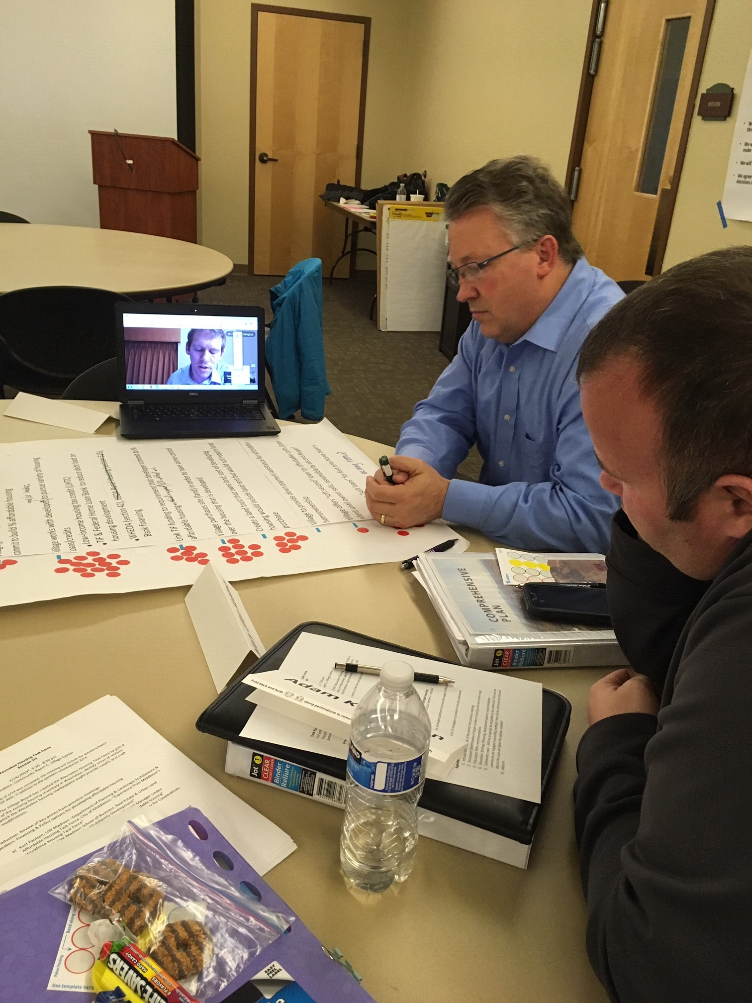
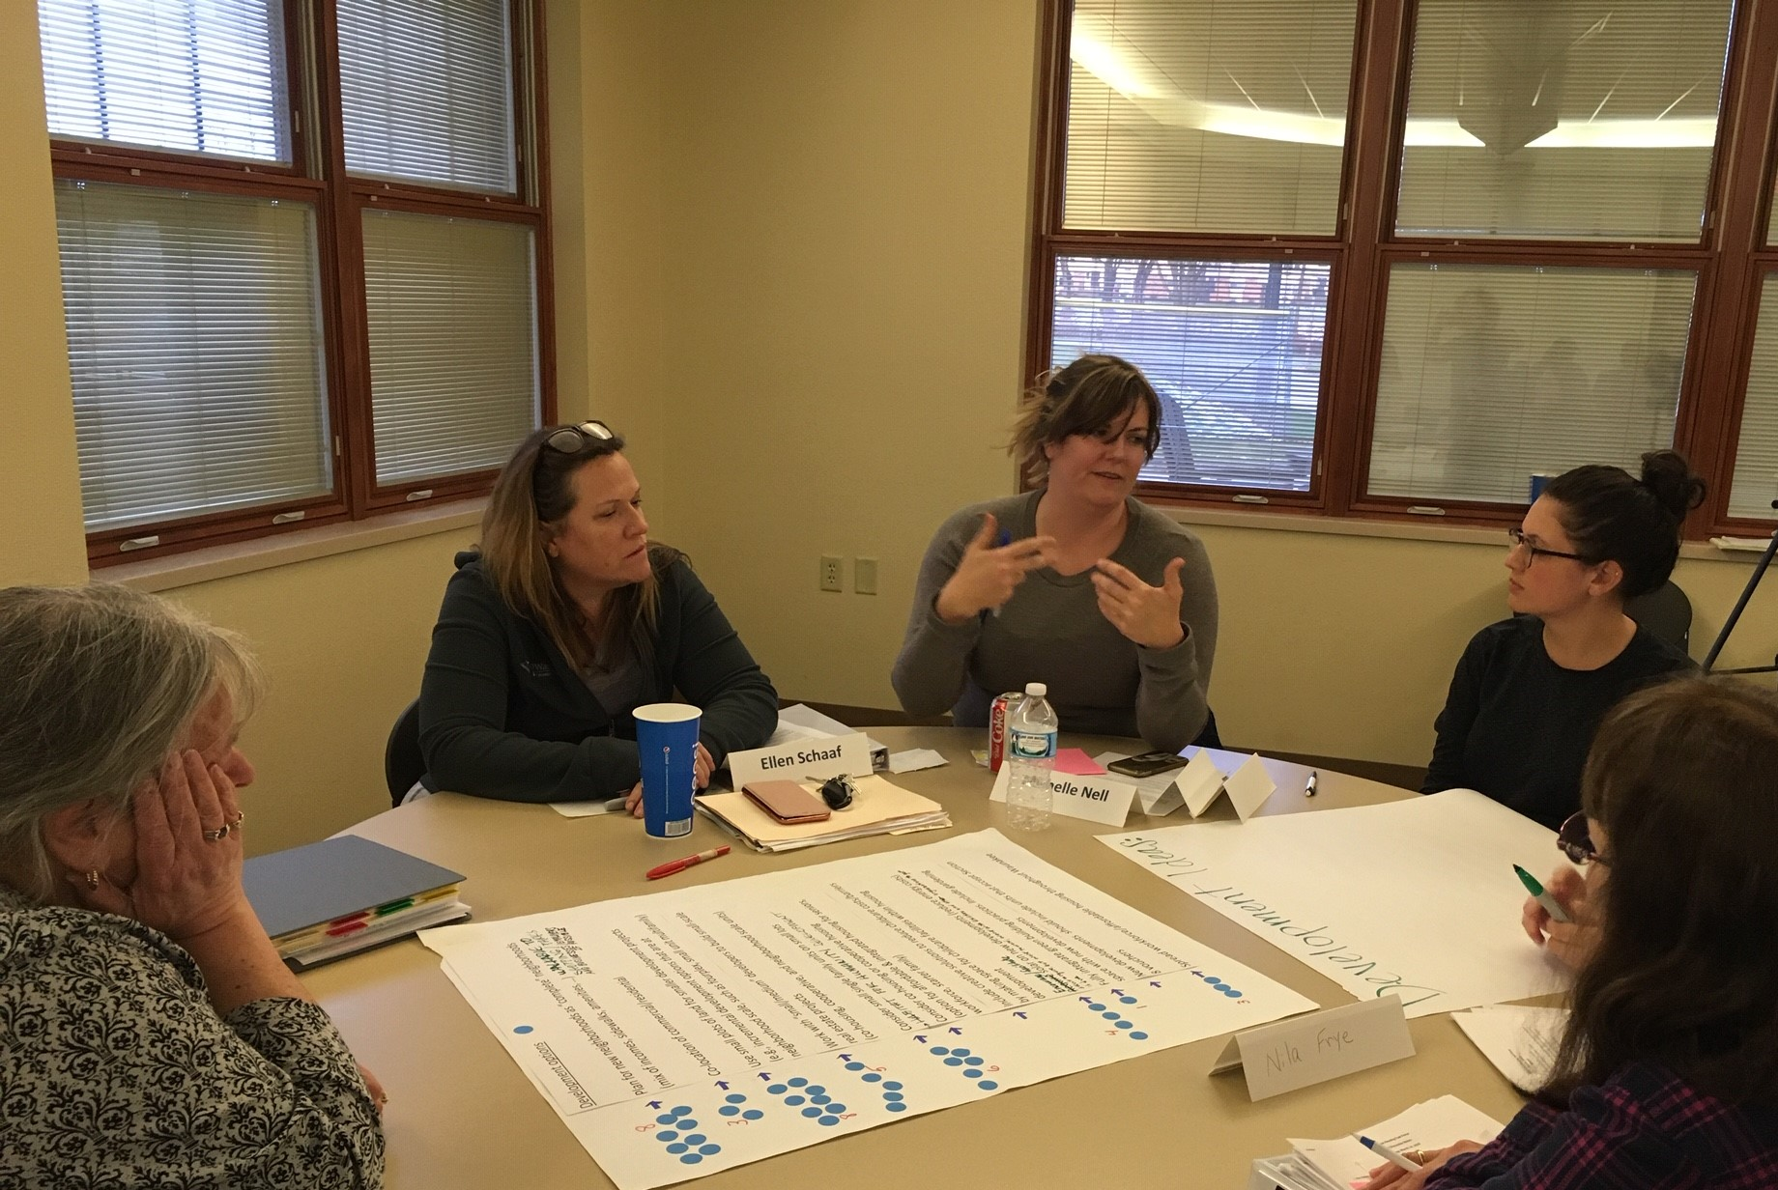
Task Force small group deliberations

Slide 14
Report Content & Key Findings
Image by Paul Whitley, via Flickr
https://www.flickr.com/photos/nbsinyk/5154118365

Slide 15
Data
Capacity
Regional growth
Resident profile
Decisions
Housing stock inventory
Housing gap
Developers
Resident survey
Commuter survey
Cost burdened household analysis
Public assistance profile
Earnings
Distance
Industry
Housing starts
HUD-estimated affordable ownership levels for county
Perception of problem
Priorities
Attitude toward specific segments
Perception of Waunakee
Price target
Perception of home prices
Willingness to move
Demographics
Income distribution
Commuter profile
Reasons they live elsewhere

Slide 16
Results & Outcomes
Image by Paul Whitley, via Flickr
https://www.flickr.com/photos/nbsinyk/5154118365

Slide 17
Work Product
Annotated Report
Task Force Web Page

Slide 18
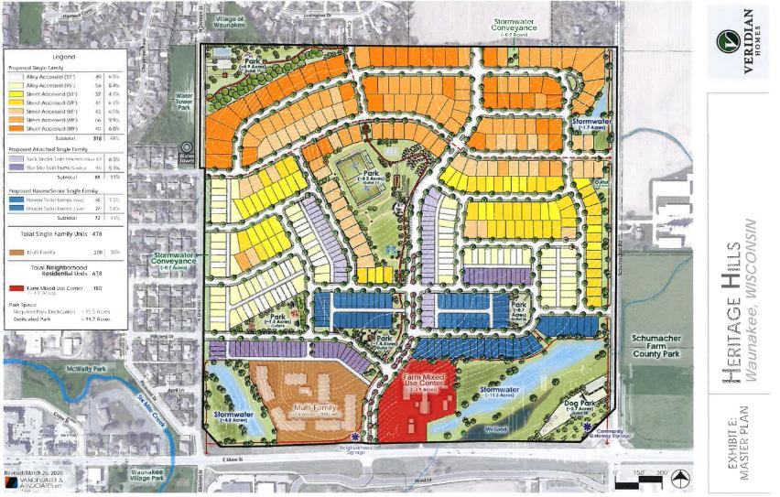
Outcomes
List of ongoing recommendations
Missing Middle subdivision
LIHTC redevelopment project
Community Development Authority

Slide 19
Lessons Learned
Image by Paul Whitley, via Flickr
https://www.flickr.com/photos/nbsinyk/5154118365

Slide 20
Process Considerations: What we’ve learned
Group Formation
Decision-making process should have been identified at start
Balance between learning (presentations) and discussions
Keep coming back to the task/purpose [develop recommendations]
Group analysis of data – how much data is the right amount?

Slide 21
More Info
Todd Schmidt
Village Administrator / Economic Development Director
Village of Waunakee
tschmidt@waunakee.com
(608)850-5227
Kristin Runge, PhD.
Community Development Institute, Division of Extension, UW-Madison
kristin.runge@wisc.edu
http://www.waunakee.com/826/Waunakee-Housing-Task-Force (or just Google it)
Notes:
Notes:
Moment of silence to digest and reflect
Sharon to report back from chat

Slide 22
Questions?
Image by Paul Whitley, via Flickr
https://www.flickr.com/photos/nbsinyk/5154118365

